Slide 1

Complex Systems:
Testing – Robustness & Antifragility
A rules engine is robust: it survives the expected. A self-learning system is antifragile: it gets stronger from every correction, every vendor change, every policy shift
Miles Waite

Slide 2



Agenda
Requirements Gathering
Robustness
Antifragile
Testing Complex Systems
1.168 – Black Swan Protection

Slide 3




Introduction
Software doesn’t fail because of bugs; it fails because of the unexpected. By capturing precise requirements (“As a User, I want… So that…”), rigorously testing complex systems, and designing for robustness and antifragility, an organisation can not only survive uncertainty but thrive in it. This approach positions us to lead the market in defending against rare, high-impact Black Swan events in daily software use

Slide 4

Requirements Gathering
As a User – I want – So that

Slide 5



Linking features to real-world value, not just listing functionality…

Slide 6
Traceable Requirements in Complex Systems
‘As a user – I want – so that…’​
is a requirements constraint, not a storytelling exercise.
It explicitly couples:
This forces every requirements to be:​
Testable — the “so that” becomes a success criteria
Capability (what the system must do)
Intent (the decision, behaviour, or outcome)
Traceable — you can map features → user outcomes → business objectives
Defensible — if the outcome isn’t clear, the requirement is weak or unnecessary
​

Slide 7
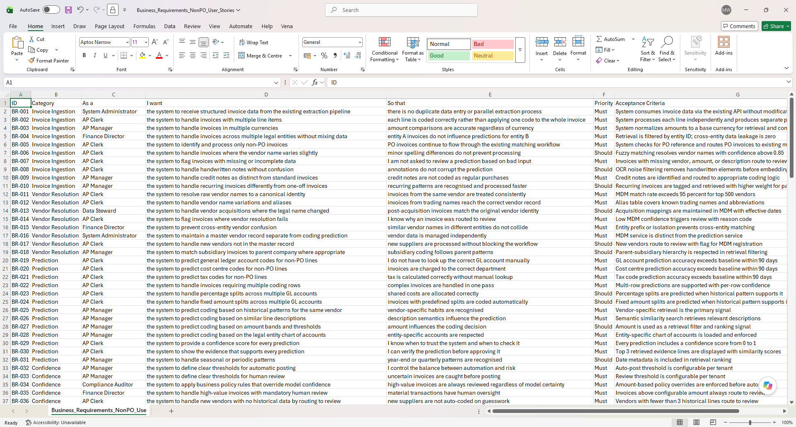
As a User – I want – So that

Slide 8
How to test complex systems under opacity
Rubricks Cubes & Fukushima

Slide 9



Like a Rubricks cube, software is an example of a complex system…
…emergent behaviour is produced from local interactions…

Slide 10
Software as a complex system exhibits:
Non-linearity – small changes can produce disproportionately large 2nd order effects
Emergence – system-level behaviour arises from local interactions
Interdependence – components are tightly coupled rather than isolated
Feedback loops – actions reinforce or dampen future behaviour
Path dependence – outcomes depend on the sequence of prior states
Opacity – internal cause–effect relationships are not fully observable
State explosion – the number of possible system states grows exponentially
Adaptive behaviour – the system responds and changes under stress
Ensemble profile– a single code fix triggers an ensemble of state changes that reshapes the overall risk profile
In complex systems non-linearity, emergence and interdependence generate silent risk: system-level failure
modes that remain hidden until the system is unexpectedly over stressed beyond ‘normal’ conditions…

Slide 11

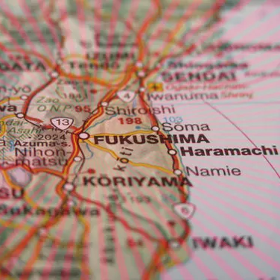
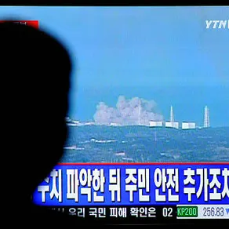
The future maxima is greater than the past maxima…
…Fukushima tested to the largest know Tsunami, not the one that actually hit…
…exposing silent risk in a supposedly robust system…

Slide 12
Robustness & Antifragility:
A rules engine is robust: it survives the expected. A self-learning system is antifragile: it gets stronger from every correction, every vendor change, every policy shift
To mitigate hidden risk we test with floating maxima – we anticipate & mitigate the impact of the unknown
Stress testing our configuration and code changes BEFORE deployment reveals silent risks
Build in redundancies to our system so we can expect the unexpected and absorb shocks
We make our systems not only robust but antifragile
Our work doesn’t just survive chaos - it thrives under it

Slide 13
What does this mean for us?
Why Robust & Antifragile Practices Matter for Enterprise Configurations
Catch hidden risks early: stress-test data models and configurations before deployment.
Maintain control and flexibility: versioning and iterative updates allow safe rollbacks.
Reduce failure impact: built-in redundancies prevent small errors from cascading.
Save money: prevent costly production failures and downtime.
Turn complexity into advantage: resilient systems not only survive but improve under stress

Slide 14

Summary
By designing for robustness and antifragility, we turn chaos into an advantage: preventing costly failures, surviving the unexpected, and thriving under stress.

Slide 15


Thank You
Miles Waite
Mileswaite.net

